Slide 1

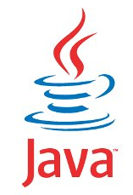
JAVA SE
(Core java)
Lecture 2

Slide 2

Today’s Agenda
Moving Ahead with JAVA
Editions Of Java
Difference Between JDK,JRE and JVM
Downloading and Installing JDK
Writing First Java Application
Complete Explanation Of First Application

Slide 3
Editions/Flavours Of Java
When java was originally released in 1996, it was just java and no such thing as “editions” was there.
But as use of java increased , then in 1999 SUN categorized it into 3 editions called J2SE,J2EE and J2ME .
Later on in 2006 they changed the naming and called them as JSE,JEE and JME.
These editions were named based on the kind of application which can be developed by learning that edition.

Slide 4
JSE(Java Standard Edition)
This is the most basic version of java and it provides us core concepts of java language like the basic types and objects as well as high-level classes that are used for networking, security, database access, graphical user interface (GUI) development etc.
Since it teaches us core concepts of java that is why many people call it CORE JAVA , although SUN never gave this name.
Used for developing desktop applications like calculators, media player, chat applications etc

Slide 5
JEE(Java Enterprise Edition)
The Java EE which stands for Java Enterprise Edition is built on top of the Java SE platform and is a collection of libraries used for building "enterprise applications" (usually web applications).
In simple terms we can say JEE is used for developing applications which run on servers.
Some popular applications developed using JEE are amazon.in,alibaba.com,irctc.co.in,ideacellular.com,airtel.in etc

Slide 6
JME(Java Micro Edition)
Java ME is the slimmer version of Java targeted towards small devices such as mobile phones.
Generally people tend to think of the micro edition as the mobile edition, in reality, the micro edition is used not just for mobile phones, but for all kinds of devices, such as television sets, printers, smartcards and more.
But as smartphone technology arrived the use of JME has reduced as Android has superseded it.

Slide 7
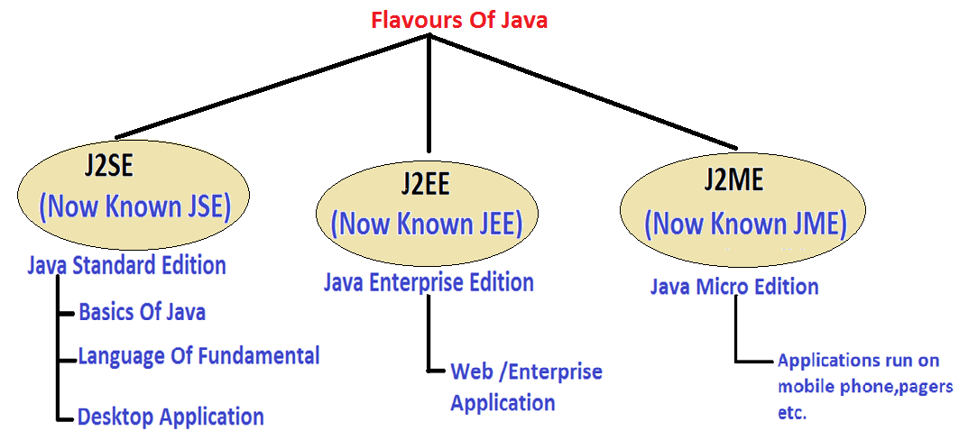
Java Editions

Slide 8
JDK v/s JRE v/s JVM
Understanding difference between JDK,JRE and JVM is very very important in java for interviews
JDK: Java Development kit
JRE: Java Runtime Environment
JVM: Java Virtual Machine

Slide 9
What Is JVM ?
JVM is an abstract machine that can execute precompiled java programs.
In simple terms it is the code execution component of java
It is designed for each platform(OS+CPU) supported by java and this means that every platform will have a different version of JVM

Slide 10
QUIZ
Why JVM is called a virtual machine ?
JVM is called virtual machine because it is a software layer but it
behaves as if it is a complete machine(platform). That is all the
tasks which are done by a machine while running a program
in other languages like C , are actually done by JVM in java.
For example: Starting the execution by calling main( ), Allocating Memory for the program,Memory cleanup etc

Slide 11
What JVM Contains?
Apart from garbage collector and other important tools , the JVM contains 2 translators:
Interpreter
JITC (Just In Time Compiler)

Slide 12
Interpreter V/s JITC
Originally java only had an interpreter which simply converted bytecode to machine language and sends it for execution to the computer.
As we know interpreters convert line by line, so the java interpreter converts one line of bytecode to machine language and sends it for execution to the computer.
Then it repeats the same process for line 2

Slide 13
Is there a problem in this approach?
Yes,
because if an instruction needs to be executed 100 times (for example inside a loop) then the interpreter needs to convert it 100 times.
For example:
a=10;
loop(i<=100)
{
print a;
}
a=10;
print a;
In the second example the interpreter will have to convert the
statement print a; 100 times since it is running inside a loop

Slide 14
Solution is JITC !
To solve this problem the developers at SUN came up with a new idea.
They thought if a statement has to be executed multiple times then why not save the converted code in computer’s memory and then next time just execute it without converting it.
That is in the previous code , the statement print a; which is inside the loop would be converted only once and saved in computer’s memory and remaining 99 times it is just executed !.
This is called JITC(Just In Time Compiler) and the statements which have to be executed multiple times are called HotSpots and thus SUN’s JVM is also called HotSpot JVM

Slide 15
QUIZ
Are java compiler and JITC same?
No , not at all.
The java compiler converts source code to bytecode and is not a
part of JVM , rather it comes with JDK.
The JITC lives inside the JVM and converts bytecode to machine
understandable form

Slide 16
What Is JRE ?
JRE is an acronym for Java Runtime Environment
It contains a JVM along with java classes/packages and set of runtime libraries.
So the JVM , while running a java program uses the classes and other libraries supplied by JRE.
If we do not want to write a java program , and we just want to run it then we only need a JRE
Notes:
time

Slide 17
What Is JDK ?
JDK stands for Java Development Kit and is a bundle of software that we can use to develop Java based applications.
It includes the JRE, set of library classes, Java compiler,jar and additional files needed to write Java applications.
Notes:
time

Slide 18
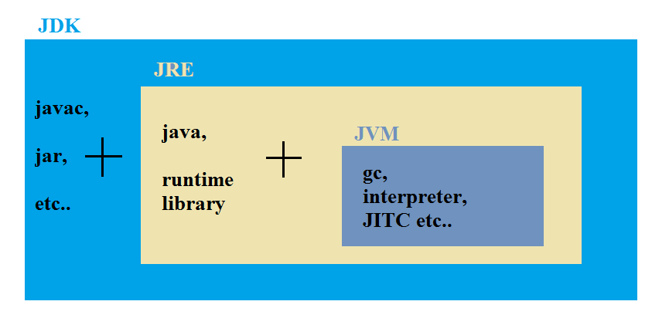
JDK,JRE and JVM
Notes:
time

Slide 20
QUIZ
Can I compile a java application if I have a JRE ?
Yes
No
JRE can only be used to run a Java application . It doesn’t contain the javac tool which is used for compilation

Slide 21
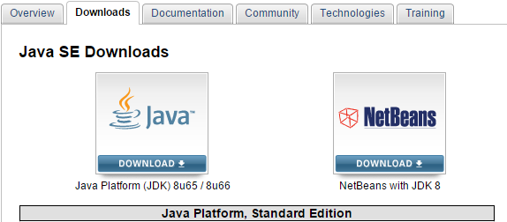
Downloading JDK
STEP 1: Go to http://www.oracle.com/technetwork/java/javase/downloads/index.html

Slide 22

Step 2 : Accept The License
Click this radio button

Slide 23
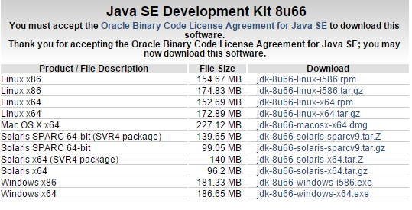
Step 3 : Choose your version

Slide 24
Step 4:
Choose Windows x86 if you are using Windows 32 bit and Windows x64 if you are using Windows 64 bit.
This version compatibility is very important for further other installations which you might need like web server installation, Eclipse IDE installation etc

Slide 25
Installing JDK
Step 5:
Now double click on the setup file which you have downloaded .
The name of the file would be jdk-8-u66-windows-x64.exe or jdk-8-u66-windows-i586.exe .
Just keep clicking next option and finally the setup will run and java would be installed on it’s default path which is c:\program files\java

Slide 26
Verifying Installation
Go to the specified path, where you install your java.
There you will see a java folder
Inside the java folder you will see two folders, one is would be jdk1.8.0_XX and other is for jre

Slide 27
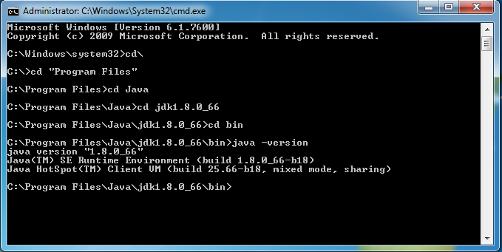
Go to start type cmd and open it by double click on it and go to javas bin folder and type java –version as shown below:-

Slide 28
Developing Java Programs
Java Program Development
Using Notepad
Typing the code in notepad and running it through command prompt. This approach is good for beginners for learning each step thoroughly
Using an IDE like Netbeans/Eclipse etc
This approach should be used after we have understood the basic working of java . Because as an IDE hides all the basic steps which are very important to understand
Notes:
Example graph/chart.

Slide 29
Developing Java Programs Using Notepad
Developing and running a program requires three main steps:
Writing the source code
Compiling the code
(Conversion from source code to bytecode)
Executing the code
(Interpretation of the bytecode)
Notes:
time

Slide 30
Step 1-Writing the Source Code
Select notepad.exe from the list shown in pop up menu of run command.
Right click and choose “run as administrator” option.
Now type the code given in next slide
Notes:
time

Slide 31
Step 1-Writing the Source Code
class Test
{
public static void main(String [ ]args)
{
System.out.println(“Hello User”);
}
}

Slide 32
Understanding The Program
First of all we must remember that java is a highly case sensitive
language.
It means that we have to be very careful about uppercase and
lowercase letters while typing the code.
For example, in the previous code three letters are compulsorily
in uppercase and they are
“T” of Test ,
“S” of String and
“S” of System.
This is because in java class names begin with upper case

Slide 33
Understanding The Program
The first statement of our code is:
class Test
Since java is an Object Oriented Language and it
strictly supports Encapsulation so every java
program must always contain at-least one class and
whatever we write must appear within the opening and
closing braces of the class

Slide 34
Understanding The Program
The second statement is
public static void main(String [ ] args)
In java also(like C/C++) the entry point of
execution of our program is the method main( ) which is called
by the JVM
The words shown in blue are keywords and each has a
different meaning and purpose for the method
main( ).
Lets understand each of them in detail

Slide 35
Why main( ) is public ?
“public” is an access modifier and in Object Oriented Programming any method or variable which is declared public can be accessible from outside of that class.
Since main( ) method is public in Java, JVM can easily access and execute it.

Slide 36
Why main( ) is static ?
Every class can have two kinds of methods , nonstatic and static.
A method which is nonstatic can only be called using object of that class , while a static method can be called without any object , simply using class name.
When the JVM makes are call to the main( ) method there is not object existing for the class being called therefore it has to have static method to allow invocation from class.

Slide 37
Why main( ) has return type void ?
The keyword void is called return type which indicates that no value will be returned by the method to it’s caller.
Since main() method in Java is not supposed to return any value to the JVM, its made void which simply means main() is not returning anything.

Slide 38
Can we change/remove the keywords used with main () ?
No , not at all.
This is because main( ) is called by JVM and to allow JVM to successfully call main( ) these keywords are important.
If we forget to write these keywords then although the code will compile but will fail to run.
All we can do is change the order of public and static but we can’t drop them

Slide 39
What is String [ ] args ?
String is a predefined class in java
So the statement String [ ] args is declaring args to be an array of Strings.
It is called command line argument and we will discuss it later.
For now, just remember that the statement String[ ] args has to be present with main( ) otherwise code will not run

Slide 40
Can we change/drop String [ ] args ?
No , just like keywords used with main are compulsorily , similarly String [ ] args is also compulsory.
All we can do is change the name from args to something else.
Also we can interchange the array name and [ ] .
For example: String args[ ], String [ ] args,
String [ ]str,String str[ ] all are valid

Slide 41
Understanding System.out.println( )
Now let’s understand code in the body of the
main( ) method, which will print a message on the console.
Syntax:
System.out.println(“ message ”);
System is a predefined class .
out is an object reference (not object).
println( ) is a method.
Together all three are used for displaying text on console.
We will discuss this part in detail once we have covered basics of java

Slide 42
QUIZ
Does every method has to be public , static and void ?
Yes
No
No , it is not a compulsion. This is only with the
main() method that we have to make it
public,static and void . All other methods have
declarations as decided by the programmer

Slide 43
QUIZ
Will a java program compile without main( )?
Yes
No
Yes, because main( ) is not needed for
compilation . But is used for execution of the
code. So we can compile a java program
without main , but we cannot run it.

Slide 44
QUIZ
What of the following are correct declarations of main( ) for java compiler?
A. public static void main(String [ ] args)
B. static public void main(String [ ] args)
C. public static int main(String [ ] args)
D. public static void main(String args)
E. public static void main(String args[ ])
F. public static void main(String x)
G. static public void main(String [ ] x)
Answer: All are correct

Slide 45
QUIZ
What of the following are correct declarations of main( ) for JVM?
A. public static void main(String [ ] args)
B. static public void main(String [ ] args)
C. public static int main(String [ ] args)
D. public static void main(String args)
E. public static void main(String args[ ])
F. public static void main(String x)
G. static public void main(String [ ] x)
Answer: A,B,E,G

Slide 46

End Of Lecture 2
For any queries mail us @: scalive4u@gmail.com
Call us @ : 0755-4271659, 7879165533
Agenda for Third Lecture:
Compilation Process And It’s Explanation
Executing The Code
Discussion About Some Important Errors
Some More Concepts

